Slide 1
Kimball - datawarehouse

Slide 2
Data Warehouse Definition
A read-only database for decision analysis
Subject Oriented
Integrated
Time variant
Nonvolatile
consisting of time stamped operational and external data.

Slide 3
Technical skills
Understand BI technology
Understand relational databases
Know company data resources
Transformation and integration tools
DBA (database administrator)

Slide 4
Business Requirements
“We have mountains of data in this company, but we can’t access it.”
“We need to slice and dice the data every which way.”
“You’ve got to make it easy for business people to get at the data directly.”
“Just show me what is important.”
“It drives me crazy to have two people present the same business metrics
at a meeting, but with different numbers.”
“We want people to use information to support more fact-based decision
making.”

Slide 5
Business Requirements
The data warehouse must make an organization’s information easily accessible.
The data warehouse must present the organization’s information consistently.
The data warehouse must be adaptive and resilient to change.
The data warehouse must be a secure bastion that protects our information assets.
The data warehouse must serve as the foundation for improved decision making.
The business community must accept the data warehouse if it is to be deemed successful.

Slide 6
Strategy
Understand your users by business area, job responsibilities, and computer tolerance.
Determine the decisions the business users want to make with the help of the data warehouse.
Identify the “best” users who make effective, high-impact decisions using the data warehouse.
Find potential new users and make them aware of the data warehouse.
Choose the most effective, actionable subset of the data to present in the data warehouse, drawn from the vast universe of possible data in yourorganization.
Make the user interfaces and applications simple and template-driven,

Slide 7
Strategy
Make sure the data is accurate and can be trusted, labeling it consistently across the enterprise.
Continuously monitor the accuracy of the data and the content of the delivered reports.
Search for new data sources, and continuously adapt the data warehouse to changing data profiles, reporting requirements, and business priorities.
Take a portion of the credit for the business decisions made using the data warehouse, and use these successes to justify your staffing, software, and hardware expenditures.
Publish the data on a regular basis.
Maintain the trust of business users.
Keep your business users, executive sponsors, and boss happy explicitly matching to the users’ cognitive processing profiles.

Slide 8
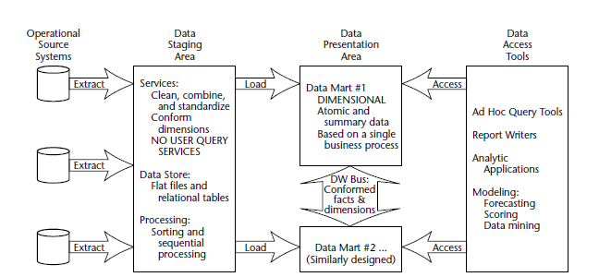
Basic elements of the data warehouse

Slide 9
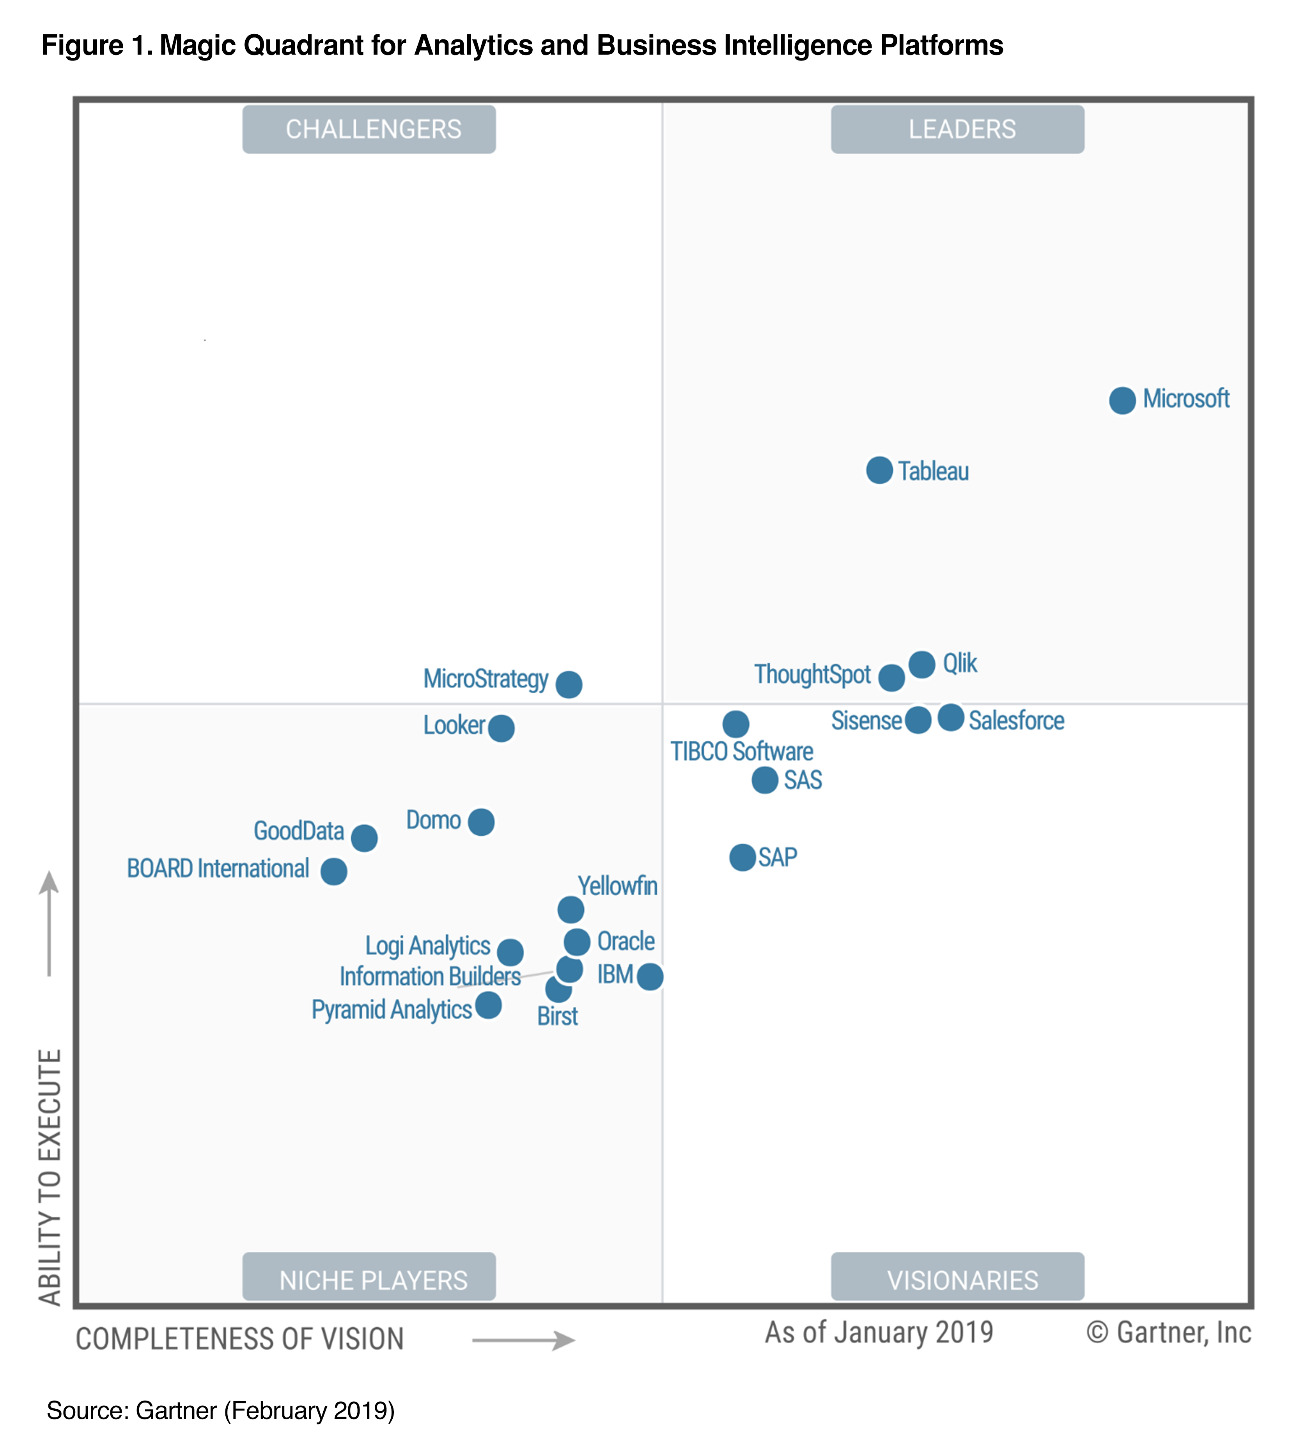
Microsoft Power BI
Getting data
Modeling
Visualizations
Exploring data

Slide 10
Staging area (kitchin)
The data staging area is everything between the operational source systems and the data presentation area.
Staging area might contains files or tables in any form.
The key architectural requirement for the data staging area is that it is off-limits to business users and does not provide query and presentation services.

Slide 11
Data cleansing
Data cleansing:
Correcting misspellings
Resolving domain conflicts
Dealing with missing elements
Parsing into standard formats
Combining data from multiple sources
Deduplicating data
Assigning warehouse keys

Slide 12
Staging in 3rd normal form
It is acceptable to create a normalized database to support the staging processes; however, this is not the end goal.
The normalized structures must be off-limits to user queries because they defeat understandability and performance.
As soon as a database supports query and presentation services, it must be considered part of the data warehouse presentation area.
By default, normalized databases are excluded from the presentation area, which should be strictly dimensionally structured.

Slide 13
Data Presentation
The data presentation area is where data is organized, stored, and made available for direct querying by users, report writers, and other analytical applications.

Slide 14
Dimensional Modelling

Slide 15
Dimensional Model
Makes databases simple and understandable.
Adimensional model contains the same information as a normalized model but packages the data in a format whose design goals are user understandability, query performance, and resilience to change.
All the data marts must be built using common dimensions and facts, which we refer to as conformed.
Data in the queryable presentation area of the data warehouse must be dimensional must be atomic, and must adhere to the data warehouse bus architecture.

Slide 16
Dimensional model from database perspective
A denormalized relational model
Made up of tables with attributes
Relationships defined by keys and foreign keys
Organized for understandability and ease of reporting rather than update
Queried and maintained by SQL or special purpose management tools.

Slide 17
OLTP vs DW
OLTP model
Data Warehouse Model
One table per entity
Minimize data redundancy
Optimize update
The Transaction Processing Model
One fact table for data organization
Maximize understandability
Optimized for retrieval
The data warehousing model

Slide 18
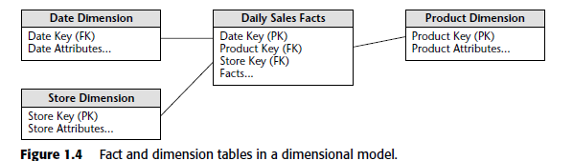

Slide 19
Surrogate Key
Wikipedia: A surrogate key (or synthetic key, entity identifier, system-generated key, database sequence number, factless key, technical key, or arbitrary unique identifier^{[citation needed]}) in a database is a unique identifier for either an entity in the modeled world or an object in the database. The surrogate key is not derived from application data, unlike a natural (or business) key which is derived from application data.

Slide 20
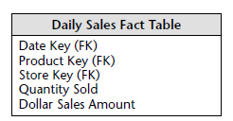
Fact Table
A fact table is the primary table in a dimensional model where the numerical performance measurements of the business are stored
The most useful facts in a fact table are numeric and additive
Fact tables express the many-to-many relationships between dimensions in dimensional models.

Slide 21
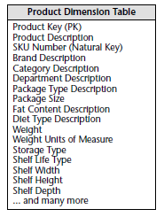
Dimension Tables
The dimension tables contain the textual descriptors of the business.
Dimension tables are the entry points into the fact table.
Robust dimension attributes deliver robust analytic slicing and dicing capabilities.
The dimensions implement the user interface to the data warehouse.
Preferably single valued for each fact record (1:m)
Connected with surrogate (generated) keys, not operational keys
Dimension tables contain text or numeric attributes

Slide 22
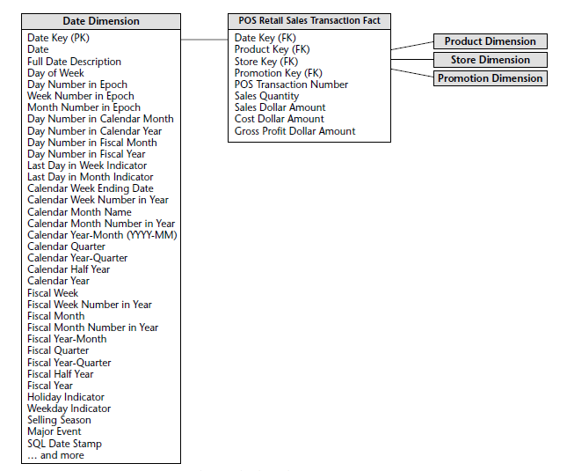
Data Dimension
Every process has a time perspective

Slide 23
Strengths of the Dimensional Model
Predictable, standard framework
Respond well to changes in user reporting needs
Relatively easy to add data without reloading tables
Standard design approaches have been developed
There exist a number of products supporting the dimensional model

Slide 24
Building a Data Warehouse from a Normalized Database
The steps
Develop a normalized entity-relationship business model of the data warehouse.
Translate this into a dimensional model. This step reflects the information and analytical characteristics of the data warehouse.
Translate this into the physical model. This reflects the changes necessary to reach the stated performance objectives.
Notes:
Designing the Perfect Data Warehouse (the paper formerly known as: Data Modeling for Data Warehouses), Frank McGuff , http://members.aol.com/fmcguff/dwmodel/

Slide 25
Structural Dimensions
The first step is the development of the structural dimensions. This step corresponds very closely to what we normally do in a relational database.
The star architecture that we will develop here depends upon taking the central intersection entities as the fact tables and building the foreign key => primary key relations as dimensions.

Slide 26
Steps in dimensional modeling
Select an associative entity for a fact table
Determine granularity
Replace operational keys with surrogate keys
Promote the keys from all hierarchies to the fact table
Add date dimension
Split all compound attributes
Add necessary categorical dimensions
Fact (varies with time) / Attribute (constant)

Slide 27
Converting an ELTP Diagram
Determine the purpose of the mart
Identify an association table as the central fact table
Determine facts to be included
Replace all keys with surrogate keys
Promote foreign keys in related tables to the fact table
Add time dimension
Refine the dimension tables

Slide 28
Fact Tables
Represent a process or reporting environment that is of value to the organization
It is important to determine the identity of the fact table and specify exactly what it represents.
Typically correspond to an associative entity in the E-R model

Slide 29
Grain (unit of analysis)
The grain determines what each fact record represents: the level of detail.
For example
Individual transactions
Snapshots (points in time)
Line items on a document
Generally better to focus on the smallest grain

Slide 30
PRODUCT
SKU (PK)
description
brand
category
CUSTOMER
customer_ID (PK)
customer_name
purchase_profile
credit_profile
address
OLTP
ORDER
order_num (PK)
customer_ID (FK)
store_ID (FK)
clerk_ID (FK)
date
ORDER-LINE
order_num (PK) (FK)
SKU (PK) (FK)
promotion_key (FK)
dollars_sold
units_sold
dollars_cost
STORE
store_ID (PK)
store_name
address
district
floor_type
CLERK
clerk_id (PK)
clerk_name
clerk_grade
PROMOTION
promotion_NUM (PK)
promotion_name
price_type
ad_type

Slide 31
DIMENSONAL
MODEL
PRODUCT
product_key (PK)
SKU
description
brand
category
TIME
time_key (PK)
SQL_date
day_of_week
month
FACT
time_key (FK)
store_key (FK)
clerk_key (FK)
product_key (FK)
customer_key (FK)
promotion_key (FK)
dollars_sold
units_sold
dollars_cost
STORE
store_key (PK)
store_ID
store_name
address
district
floor_type
CUSTOMER
customer_key (PK)
customer_name
purchase_profile
credit_profile
address
CLERK
clerk_key (PK)
clerk_id
clerk_name
clerk_grade
PROMOTION
promotion_key (PK)
promotion_name
price_type
ad_type

Slide 32
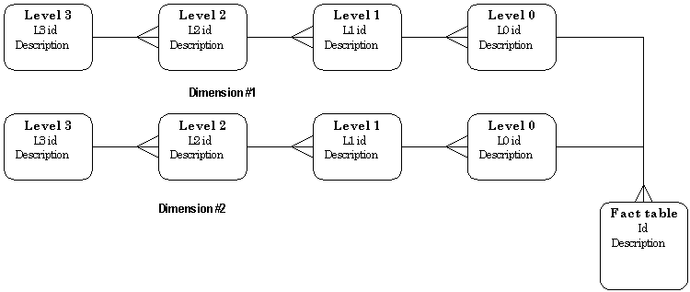
Simple DW hierarchy pattern.

Slide 33
Good Attributes
Verbose
Descriptive
Complete
Quality assured
Indexed (b-tree vs bitmap)
Equally available
Documented

Slide 34
Date Dimensions

